Slide 1
OpenMRS Roles and Privileges
A programmer's guide

Slide 2

Introduction
Medical data is usually sensitive information
Data privacy must be taken very seriously
OpenMRS has a security model based around roles and privileges

Slide 3
What's a privilege?
It's the ability to do a specific action, e.g.
View patient records
Edit encounters for a patient
In OpenMRS these usually follow a naming convention of "<Verb> <Noun>", e.g.
View Patients
Edit Encounters
Add Location
Delete Observation

Slide 4

What's a role?
It's a collection of privileges required to do a particular job, e.g.
Provider requires
View Patients, Edit Patients
View Encounters, Edit Encounters
etc
Data clerk requires:
Add Encounters,
Administrator requires:
ALL privileges!

Slide 5
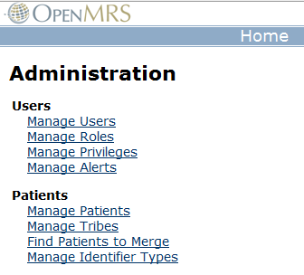
Managing roles and privileges
Administrators can manage roles and privileges from inside OpenMRS..

Slide 6
Defining privileges
A module can define new privileges
These must be added to its config.xml
For example, in the Appointments module…
<privilege>
<name>View Appointments</name>
<description>Able to view patient appointments</description>
</privilege>
<privilege>
<name>Edit Appointments</name>
<description>Able to edit patient appointments</description>
</privilege>

Slide 7
Checking privileges
There are several points in a module where we can and should check privileges...
On service methods
On JSP pages
On certain extension points that we are using

Slide 8
Privileges via Extension Points
Privileges are built in to extension points. A class that extends PatientDashboardTabExt has a method for privileges. Anyone without the privilege will not see the extension point.
public class PatientDashboardExt extends PatientDashboardTabExt {
@Override
public String getRequiredPrivilege() {
return "View Appointments";
}
Simply change the return for getRequiredPrivilege() to match the privilege specified in the config file.

Slide 9
Privileges in the Model
To allow or deny access to data accessed by a specific method use annotated privileges.
//Inside the AppointmentService interface:
/**
* Get the appointments from the database for a given patient
* @return
*/
public Collection<Appointment> getAppointments(Patient patient);
/**
* Save an appointment to the database
* @param appointment
*/
@Authorized( { "Edit Appointments" } )
public Appointment saveAppointment(Appointment appointment);
Use the @Authorized tag to set privileges at a method level.

Slide 10
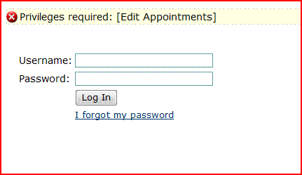
Annotated Privilege Result
This is the result of attempting to submit an appointment form as the user “doctor” who has a role of type Provider when Provider can view appointments but not edit them.

Slide 11
Privileges in the Controller
You might need access to the privilege as you write logic for your page. Imagine, you want to send the user to one page if they have privileges and a different page if they don’t or you want to process your data in one way if there are privileges and another if there aren’t (maybe you want to change a name to XXX before displaying a patient record for a given privilege).
You can control the privileges at the web layer as follows:
if(Context.getUserContext().hasPrivilege("Edit Appointments")) {
// Logic for editing
} else {
// Logic for viewing
}

Slide 12
Modifying the View Based on Privileges
For instance, on the form to enter appointments, you can let people view the information without letting them try to submit:
<tr>
<td>Reason:</td>
<td><form:input path="reason" /></td>
<td><form:errors path="reason" cssClass="error" /></td>
</tr>
</table>
<br>
<c:choose>
<c:when test="${privilege == 'edit'}">
<input type="submit" align="center" value="Do It!">
</c:when>
<c:otherwise>You do not have permissions to add/edit this appointment</c:otherwise>
</c:choose>

Slide 13
Modifying the View Based on Privileges—Another Way
Used to hide page elements if user does not have a required privilege
Elements to be hidden are put in the tag body, e.g.
<openmrs:hasPrivilege privilege="Edit Patients">
...
Page items that user should only be able to see if they
have the "Edit Patients" privilege
...
</openmrs:hasPrivilege>

